Slide 1
D.A.R.S.H.A.N Device for Avoidance of Remotely Sensed Hurdles And Navigation
Nikhil Anand B – 1BM16EC065
Ranjith D – 1BM16EC087
Pranava Y N – 1BM16EC005
Prajwal V Holla – 1BM16EC079
Guide – Prof K R Sudhindra

Slide 2
AREA OF APPLICATION
Object Detection and Recognition
Device focused for helping visually impaired people to make their life smoother.

Slide 3
INTRODUCTION
Convolution Neural Network – CNN
You Only Look Once – YOLO
RaspberryPi

Slide 4
PROBLEM ANALYSIS AND DISCUSSION
Dire need for visually impaired people to navigate their life more easily.
Need for information regarding objects around them with which they can interact.
Need for a fast and efficient object detection/recognition for the purpose.

Slide 5
CONVOLUTIONAL NEURAL NETWORK
A deep learning algorithm
Requires much less computation and pre-processing
Its just a set of filters
Widely used in image recognition and classification

Slide 6

CONVOLUTIONAL NEURAL NETWORKS

Slide 7
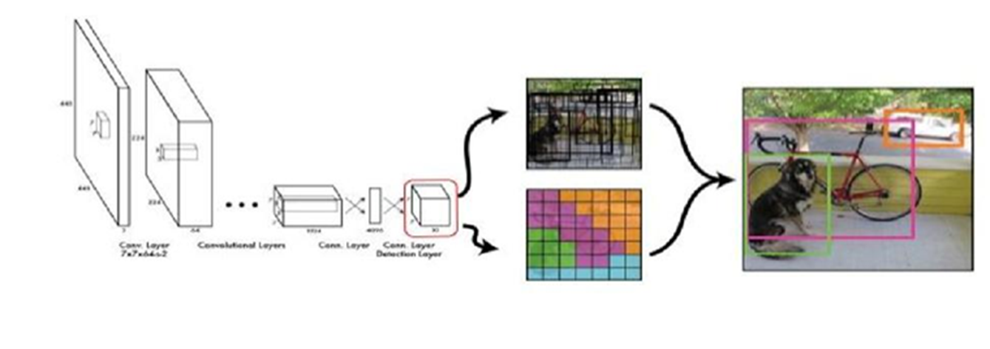
YOLO (You Only Look Once)

Slide 8
YOLO ARCHITECTURE
Convolutional Layer
Max Pooling Layer
Feature size reduction
ReLU Activation Layer (Leaky ReLU)
Introducing non linearity
Fully Connected Layer

Slide 9
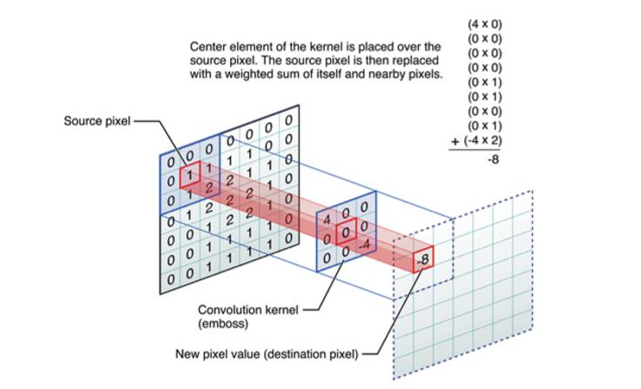
CONVOLUTIONAL LAYER

Slide 10
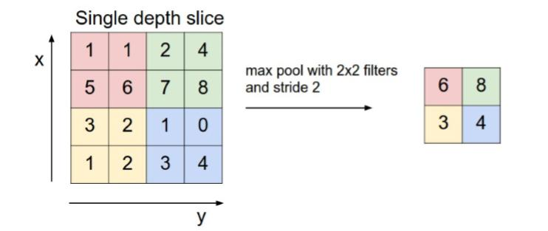
MAX POOLING LAYER

Slide 11
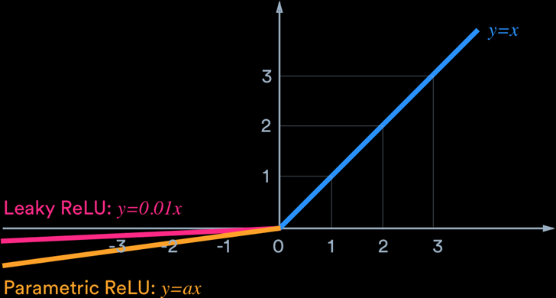
ReLU LAYER
Activation function
Requires less computation
Induces non linearity in the network

Slide 12
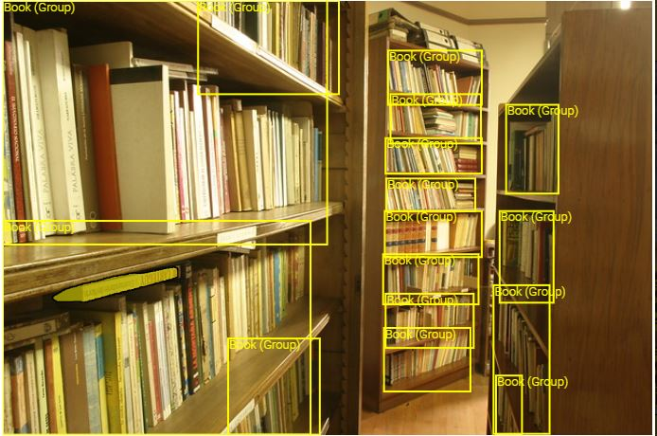
Training the model
Creating a custom dataset
Open Images dataset(OID)- A collaborative release of ~9 million images annotated with image-level labels, object bounding boxes, object segmentation masks, and visual relationships.
Set up by google, consists of over 600 classes
OIDv4 toolkit.
Python script to convert from the OIDv4 toolkit version to yolo version of labels
Classes – chair, monitor, book, water bottle

Slide 13
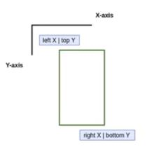
Training the model
Creating a custom dataset
400 images are obtained for each class
2 Csv files are used for indexing the images
Images with labels & annotations(co-ordinates )
OIDv4 toolkit Format - Top left & bottom right co-ordinates
Convertion of annotations into yolo v3 normalized version
The labels(names like book, mouse, etc) are converted into a numbered value
Fig. OIDv4 toolkit format

Slide 14
IMPLEMENTATION METHODOLOGY
HARDWARE ARCHITECTURE
PC (INTEL I5, 4Gb RAM) + Webcam
Raspberry Pi + Raspberry Pi Camera (PiCam)
SOFTWARE ARCHITECTURE
Python 3.7
cv2 (Opencv 3)
speech_recognition (Google Speech to Text engine)
Pyttsx3
numpy

Slide 15
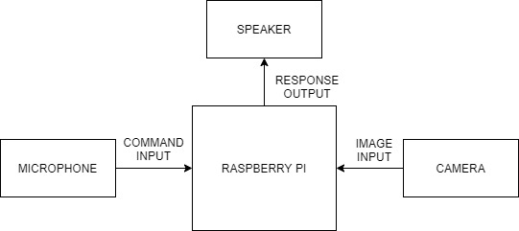
HARDWARE IMPLEMENTATION

Slide 16
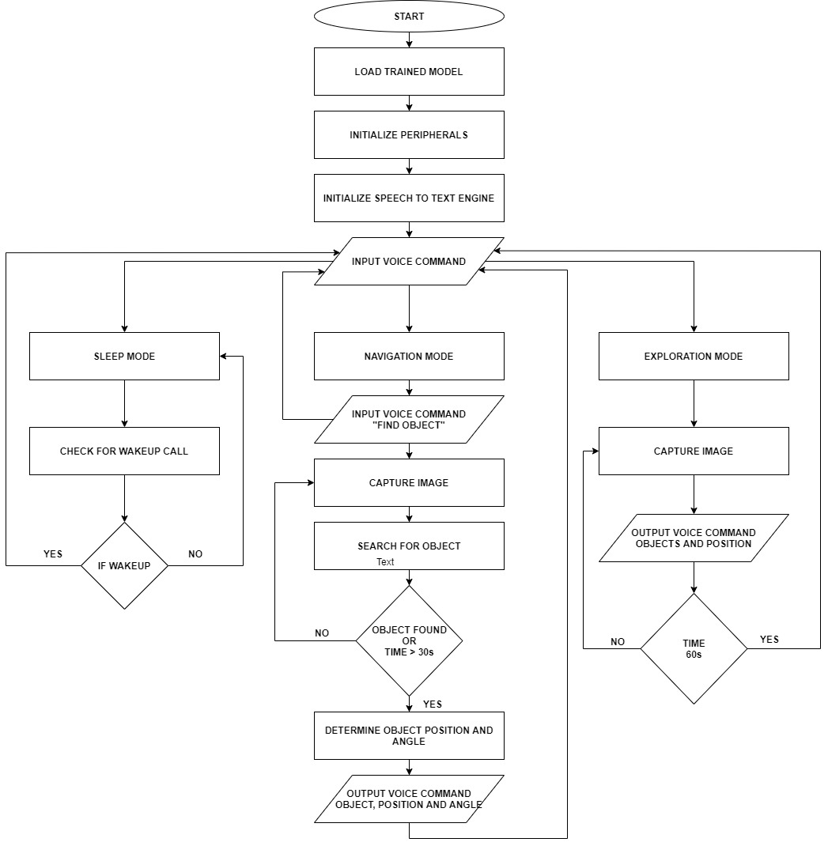

Slide 17
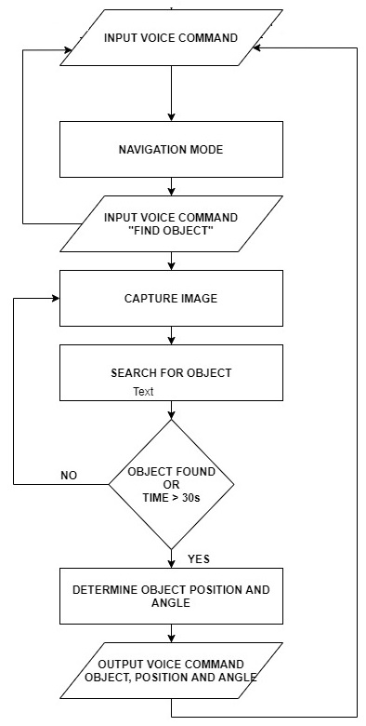
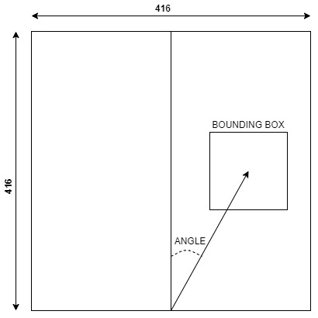
Navigation mode

Slide 18
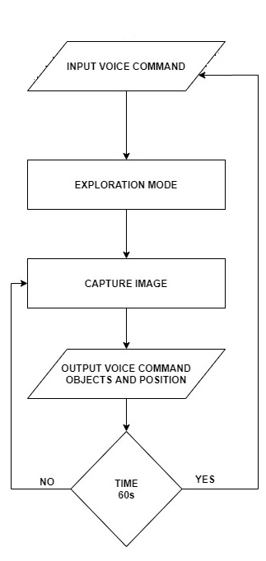
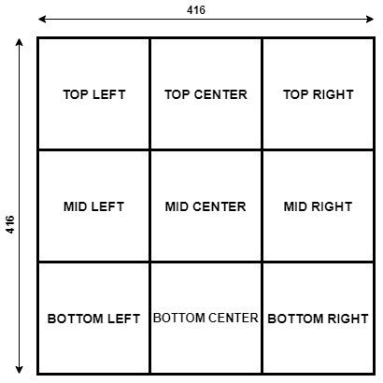
Exploration mode

Slide 19
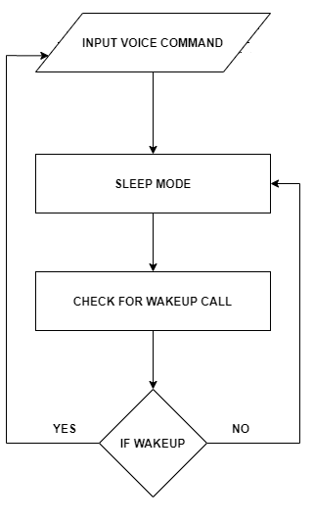
SLEEP MODE

Slide 20
SOFTWARE IMPLEMENTATION
Functions used for object detection
cv2.dnn.blobFromImage
cv2.dnn.readNetFromDarknet
cv2.dnn.readNetFromDarknet.setInput
cv2.dnn.readNetFromDarkNet.forward

Slide 21
cv2.dnn.blobFromImage
For deep learning and image classification the images must be preprocessed. The preprocessing tasks mainly involve Mean Subtraction and Scaling.
Mean Subtraction is used to help combat illumination changes in the input images. First the average across all channels (RGB) is calculated. Then new pixel values are given as R=R-R_avg, G=G-G_avg and B=B-B_avg.
The RGB intensity can be scaled too by a factor µ as R=R/ µ,G=G/ µ and B=B/ µ to normalize the pixel values.
The value of µ is decided manually or can be set as the standard deviation across the training set.

Slide 22
cv2.dnn.readNetFromDarknet
The function cv2.dnn.readNetFromDarknet is used to read a network stored in Darknet model files.
The Darknet is an open source neural network framework written in C
The above function requires two arguments config_file and darknetModel.
The config_file is a text description of the network architecture whereas the darknetModel is the .weights file with learned network.

Slide 23
cv2.dnn.readNetFromDarknet.setInput
The function cv2.dnn.readNetFromDarknet.setInput sets the input to the Neural Network and it’s input argument is blob.
The blob is a preprocessed image with four dimensions namely num_images, num_channels, width and height.
The blob can be obtained by cv2.dnn.blobFromImage or cv2.dnn.blobFromImages.

Slide 24
cv2.dnn.readNetFromDarkNet.forward
This function is used to forward pass to compute the layer outputs for the required layers.
To get the required output layer computations we enter the layer names in the parameters.
The function returns a blob for first output of a specified layer.

Slide 25
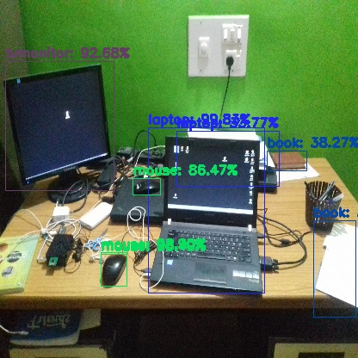
RESULTS

Slide 26
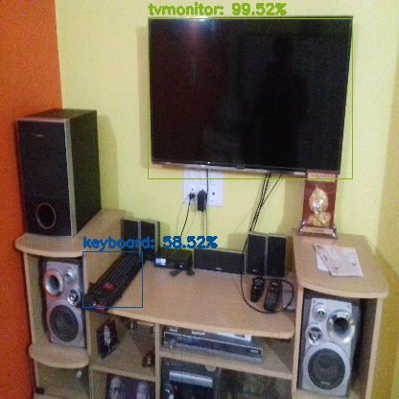
RESULTS

Slide 27
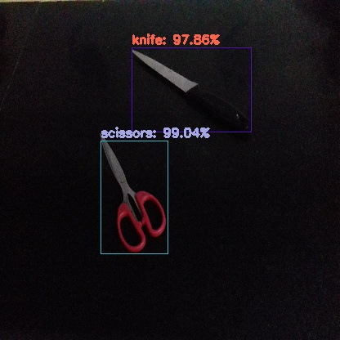
RESULTS

Slide 28
RESULTS
VIDEO

Slide 29
FUTURE ENHANCEMENTS
Increasing speed and accuracy of the process
Integrating sensors to increase functionality
Android app development
Developing faster models for specific scenarios

